Slide 1

Short term rentals,
A good idea for Watershed?

Slide 2
Recommendation
9 most profitable properties
Miami FL, Austin TX, San Diego LA.
1 and 2 bedroom houses
$650k → $592k

Slide 3
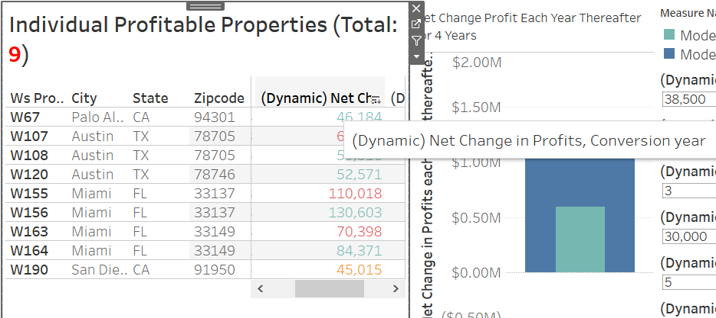

Slide 4
We will now see the effect of Transaction fees on the profitability of properties

Slide 5
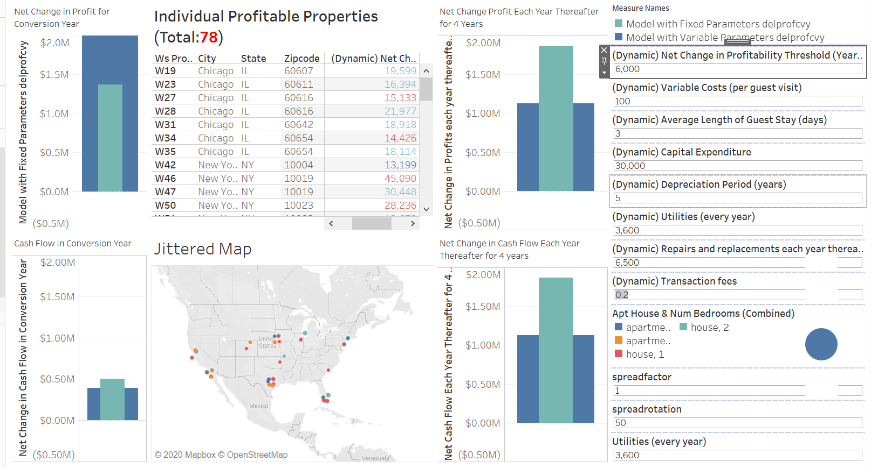

Slide 6
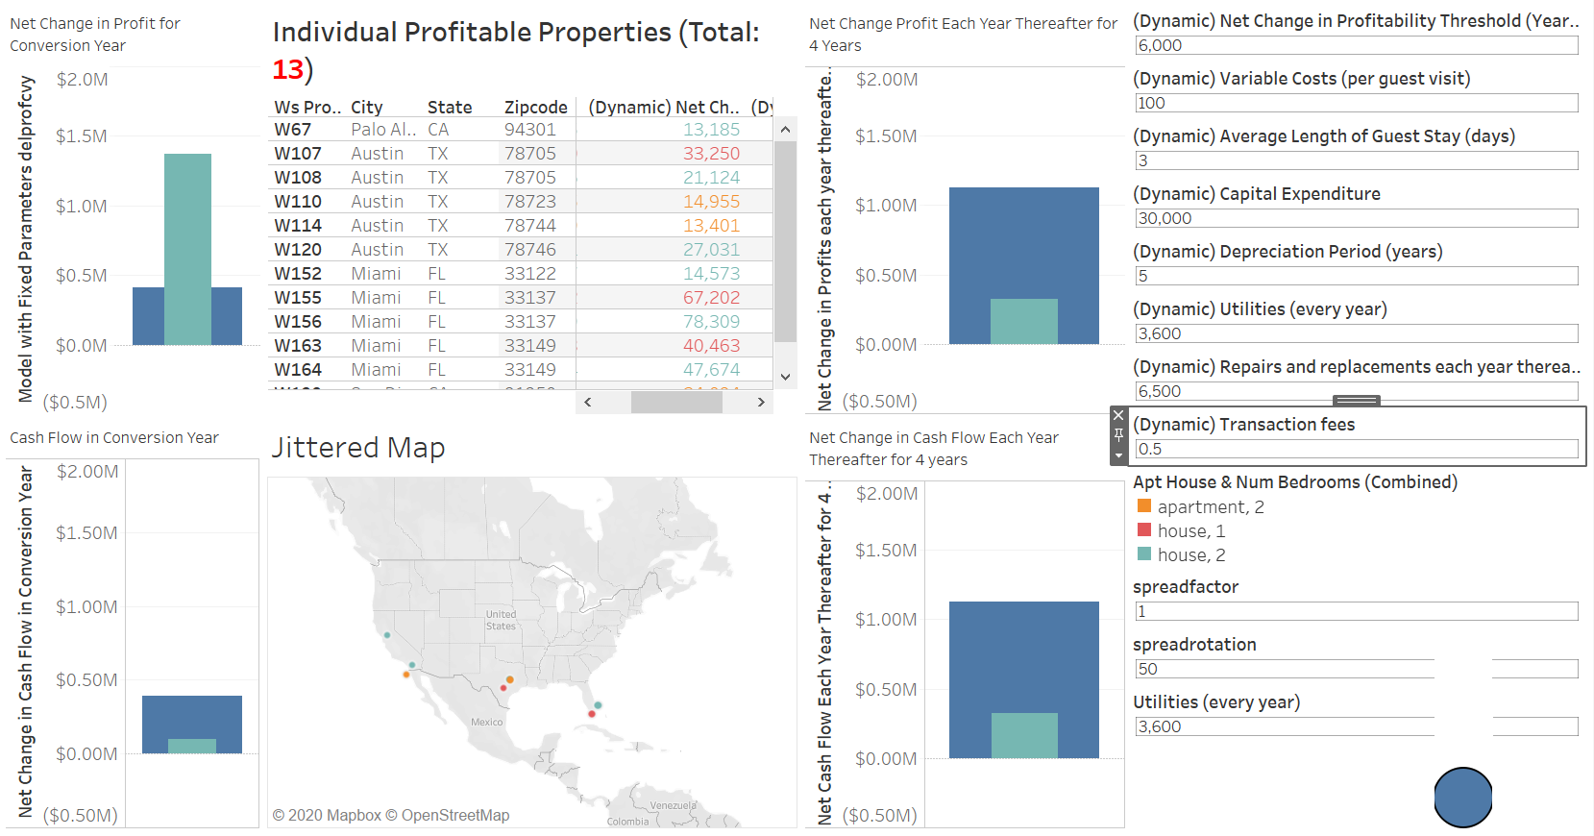

Slide 7
We will now check the best and the worst case possible with our conservative profit threshold of $38500

Slide 8
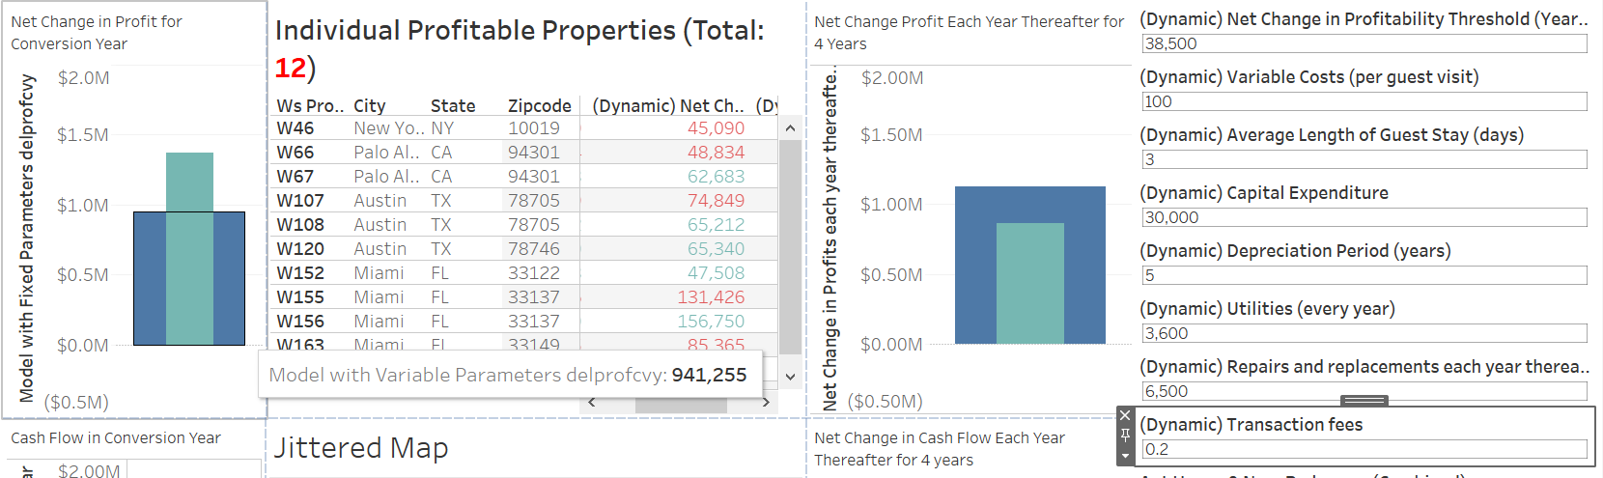

Slide 9
Profit in the Conversion year: $941255
Transaction Fees: 20%

Slide 10
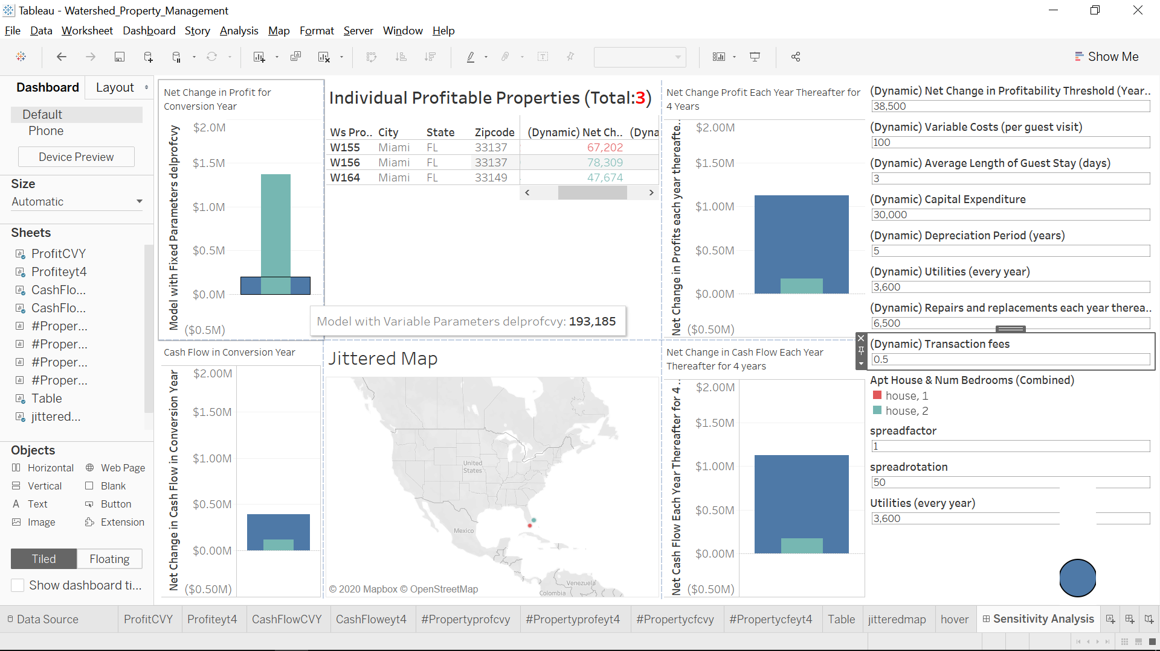

Slide 11
Profit in the Conversion year: $193, 185
Transaction Fees: 50%

